Slide 1
College and Postsecondary Planning
Class of 2022 Seniors!

Slide 2
Overview:
Important Updates: Resources, College Rep Visits
College Selection Process, Types of Colleges/Applications
Transcript Requests
Letters of Recommendation
Essays
Xello – Update Email, Planning Survey
Application Help Resources– Counselor Appts, Workshops

Slide 3
College Information Specialist: Mrs. Linda Dowley
Weekly articles with important information regarding applying to college, tips and strategies in selecting your college list, choosing extracurriculars, writing your essays, testing information and more!
Every Wed in the Enews!
Will also send to you via Xello.
Senior To-Do List by month is here:
WWW.LJHSCOLLEGEINFO.COM

Slide 4
College Rep Virtual Visits
They are usually the same person who will review your application - so introduce yourself and come armed with good questions!
Attending these sessions is a great way to demonstrate interest.
Availability and sign ups are TBD
If there is a session you can’t attend email the representative directly to connect and ask questions.

Slide 5
Virtual College Visits
Check individual college websites for offerings.
For direct links to over 900 colleges’ tours, live info sessions and youtube channels, check out this resource:
https://docs.google.com/spreadsheets/u/1/d/1sO7pVos0EvK0BvXoMbnyg00K6r7hXbOQE0HNXF4N4eM/htmlview?usp=sharing&fbclid=IwAR1Vr3WcvpwflVMsaXnzlMq9ibN3oMMAG8x02F0w6o4nsWr2PSlTkenQoqM
https://www.youvisit.com/collegesearch/
Emails from Xello will also share information on virtual college fairs and special information sessions offered by colleges.

Slide 6
College Selection: The Strategy
Reach Schools (2-3)
Dream 0-20% chance of acceptance
Match Schools (4-6)
Realistic 70-80% chance of acceptance
Safety Schools (2-3)
High likelihood of acceptance
Apply to 8-12 colleges.

Slide 7
Types of 4 Year Schools
California State University – examples: San Diego State, Cal Poly San Luis Obispo, Chico
2. University of California – examples: UCSD, UCLA, UC Berkeley, UC Davis
3. Out-of-State Public Schools – examples: U of Arizona; U of Oregon; U of Delaware, Clemson, Rutgers
4. Private Schools – examples: Stanford, USC, Harvard, Duke, Emory, Gonzaga, Tufts, UPenn

Slide 8
College Application Choices
Early Decision - Binding
- Only ONE college allowed, and it should be your 1st choice.
Early Action – Non-Binding
May apply to more than one school
EARLY: More competitive- usually top % of applicants
Due dates start in OCTOBER
Regular Decision varies by college- check website
Rolling – Can apply anytime, notified several weeks after applying
Notes:
More competitive position before RD applicants (1500 vs 5000)
If your application is polished then apply EA

Slide 9
California State University System (CSU) Apply: Oct 1 – Nov 30
23 campuses
Admission based only on:
GPA: grades 10-11 only
NO SAT/ACT
Min. GPA 2.0
Honors Programs Available! *Many benefits including small class size- 35! (Regular class:100+)
No letters of recommendation!
Transcript not sent until JUNE 2022!
https://www2.calstate.edu/apply

Slide 10
SAT/ACT - COVID implications
CSU- Will not use ACT/SAT scores for 2022 admission.
(If you have already have a score, it will be used for placement in Math/English courses only.)
​Impacted campuses will use your “a-g” GPA and supplemental factors to inform campus admission decisions, such as:
# courses exceeding minimum “a-g” requirements (ie. 4 years of math; 3-4 years Science)
extracurricular involvement
Be sure to check the admissions webpage for the CSU campuses in which you are interested in attending to know which specific factors the campus will be using.​​​

Slide 11
University of California System (UC) Open now – Submit Nov. 1 - 30th
9 undergraduate campuses
Admission based on:
GPA: grades 10-11 only
NO SAT/ACT required
Extracurricular Activities
4 Short Insight Questions
Minimum GPA 3.0
No letters of recommendation!
Transcript not sent until JUNE 2022!
www.universityofcalifornia.edu/admissions

Slide 12
SAT/ACT - COVID implications
UC: Will not use ACT/SAT scores for 2022 admission.
If you submit scores, they may be used as an alternative of fulfilling minimum requirements for eligibility or course placement.
Private/Out of State:
Many are not requiring them for Fall 2022 admission- but you must check individual websites.
For a list of all schools that do not use ACT/SAT, including those just for fall 2022: http://www.fairtest.org/

Slide 13
Private & Out of State Universities
Admission requirements vary by institution, but most follow similar UC/CSU guidelines in terms of subject requirements and test requirements.
Check individual campus websites to determine admission requirements!
GPA: grades 9- 12th (Fall semester)
SAT/ACT – Most are NOT requiring them. Check each school’s website
Essay/Personal Statement
Letters of Recommendation
Extracurricular Activities
Deadlines vary greatly; be sure to check each school’s policies!!!

Slide 14
WUE – Western Undergraduate Exchange
https://www.wiche.edu/tuition-savings/wue/

Slide 15
Application Deadline Review
CSU- California State University
Not open until October 1 – November 30
UC – University of California
Open Now, submit November 1 – November 30
Private and Out of State Schools
Common App is open now.
Due dates vary by school. (most common are Nov.1/15, Dec. 1/15, Jan 1, Feb 1)
Check college’s website for accurate dates.

Slide 16
College Application Information
You will need this information for our school when filling out the applications:
1) Graduation Date – 06/14/22
2) Counselor name and contact information (on website)
3) We do not rank!
4) Class size = 323
5) Cumulative GPA – Your 10-12 WGPA (top of transcript)
6) GPA Scale - 4.0
7) GPA Weighting - Weighted
8) Your transcript

Slide 17
Academic Sections on Applications: Semesters – Quarters at LJHS
Our grading system is semesters: earn 2 semester grades per class. *2020-21: grades reported on a quarter system, but you will need to enter as semesters
Common App:
Current/Most Recent Year Courses = Semester system
UC:
Academic History = Select semester
Most courses are Yearlong, College classes are semester long.
(AP Gov= Semester 1, AP Econ Semester 2)
See tutorial at end

Slide 18
College Courses - Dual Enrollment
All college classes taken (at LJHS or off campus) must be entered on college applications under “College Courses Taken.”
You will first need to list the colleges you have attended, and then add the course title, number and credits earned.
Mesa/UCSD dual enrollment courses offered at LJHS:
https://drive.google.com/file/d/1Wt5ltsHmdTs5kbT0Hm2rZAcEltysIarC/view?usp=sharing

Slide 19
UC/CSU Application Information
UC/CSU A-G course list
IMPORTANT: Refer to your original transcripts from all schools attended. This includes Charter, Mesa College, out of state/country, etc.
If not on the menu (i.e. not a CA school), report it in the designated area.
Must meet a-g minimum requirements by graduation.

Slide 20
Community Colleges

Slide 21
Community Colleges
In every area across California!
Transfer to a 4 year is generally easier than for freshman.
Affordable, and free with the PROMISE SCHOLARSHIP.
Conveniently located, small class sizes.
Associates degrees, select Bachelors degrees, and certifications offered.
Transfer requirements:
Private – some after 1 year
Public – must have completed 60 units (approx. 2 yrs)

Slide 22
Community College Planning
Application process is done in the spring.
Make sure to list at least one CC on Xello. We will add you to a list of students who gets additional advising throughout the year from a Mesa College ambassador.

Slide 23
Alternative Options
Military, Border Patrol, Law Enforcement,
etc.
SDCE: FREE, local, job training and courses.
Gap Year
(Travel, Work, etc.)

Slide 24
Have a college list or plan? Your Next Steps:
Order transcripts.
Ask for letters of recommendation.
Meet with your counselor!
Complete your application on time –
Don’t wait for your teacher/counselor to submit their recommendation! Submit your app as soon as it’s done! ☺

Slide 25
1. Order Transcripts
All colleges are entered in Xello w/correct deadlines.
Sign the FERPA waiver for Common App Schools
Request your transcript through Xello.
https://clever.com/
** AT LEAST 3 WEEKS PRIOR TO DEADLINE! **

Slide 26
1. Order Transcripts - continued
If you attended a school outside of our district:
You MUST order OFFICIAL transcripts from them directly. (For example, go to https://myportal.sdccd.edu/ for Mesa College transcript orders.)

Slide 27
Enter colleges into Xello
Go to College planning and then Create new Application:
Make sure you specify the deadline stated on the applicaiton!
Early or Regular
You must look up application date through common app or UC/CSU portal

Slide 28
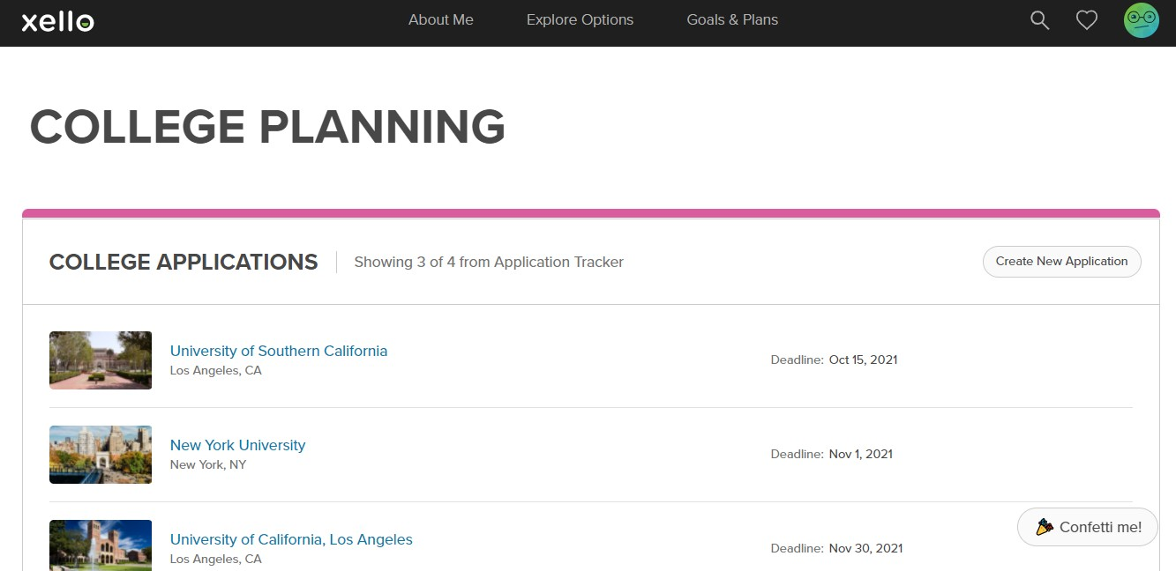
Xello - Transcript Requests
1. Create list in:
2. Click on Manage Applications:
Notes:
Xello transcript request

Slide 29
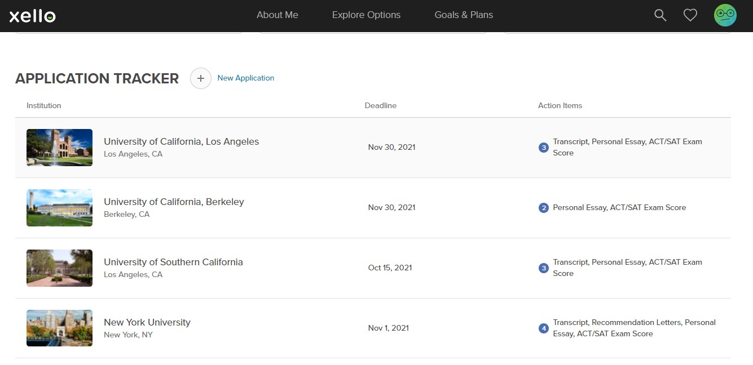
Xello - Transcript Requests
College Applications list: Check all due dates!
This message indicates that your transcript request has been submitted: “Your high school is processing your transcript.” If the status does not change in 2 days, contact your school counselor.
Notes:
Xello transcript request

Slide 30
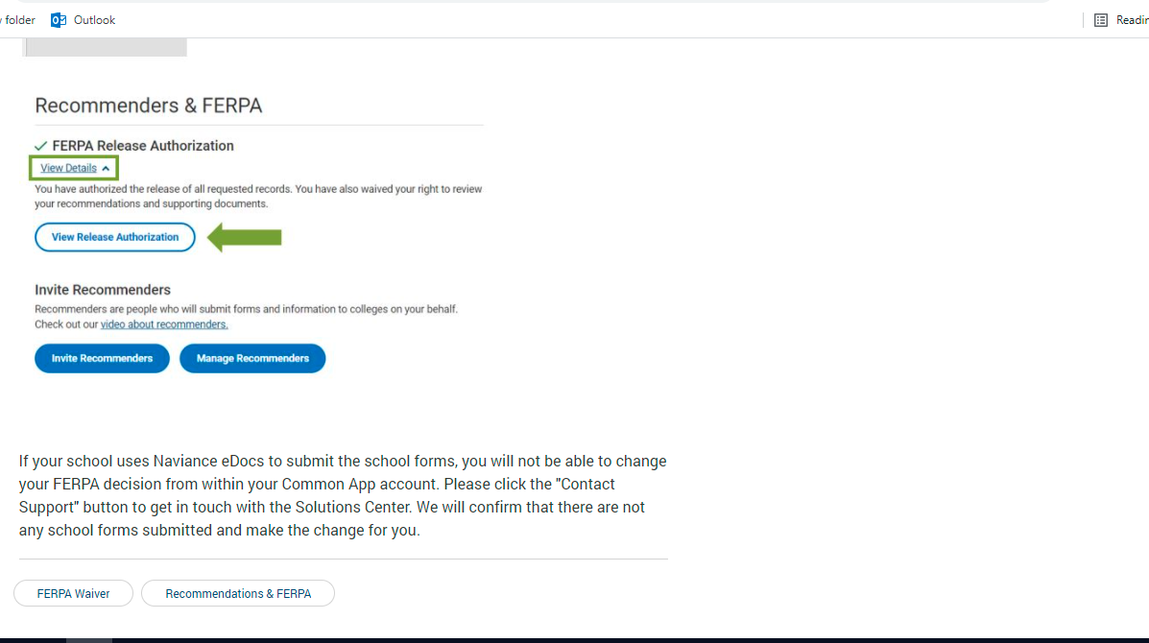
Naviance - Transcript Requests
Common App Matching - FERPA waiver

Slide 31
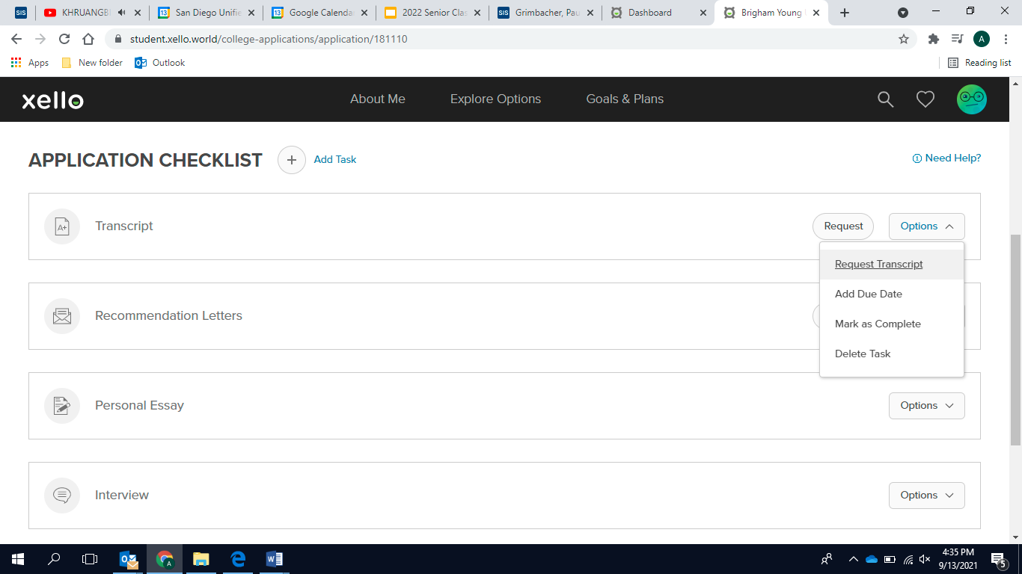
2. Letters of Recommendation
Most schools require 2 teachers & 1 counselor (or 3rd teacher)
Ask NOW (before you request in Xello)
FOR TEACHERS: add request on Xello.
Choose specific colleges…

Slide 32
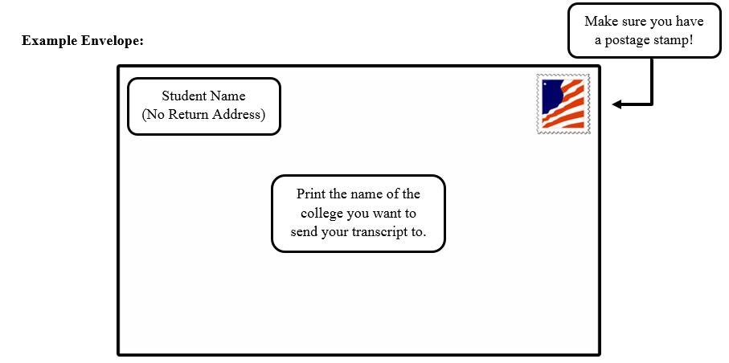
NON- LJHS Teacher Recs
Download the Teacher Evaluation Form in the Common Application, and email to the teacher.
Provide the mailing address of the school or the email of the admission rep - They will mail the letter for you.
Please talk to your counselor for help with this step!
Do NOT use the
“Other Recommender”
in the Common App!
letter

Slide 33
Teacher Rec Letters
Contact your teacher first
Request in Common App
Please do at least 3+ weeks before the deadline.
Write a THANK YOU note!
☺

Slide 34
Counselor Rec Letters
Student Input Survey, Parent Input Survey, and Resume in Naviance
If those are incomplete, I won't be able to write a letter for you.
We need at least a 2-3 week notice before your application deadline
You can also request a third Teacher to write a letter in place of the Counselor letter if you choose to do so
Make an appointment with your counselor!

Slide 35
Essays – Personal Statement
Required for…
UC – choose four out of eight prompts https://admission.universityofcalifornia.edu/how-to-apply/applying-as-a-freshman/personal-insight-questions.html
Common Application – 1 essay, plus supplements
Private schools
Some out-of-state schools
Revise, revise, revise!
Do not send without having someone review it. (Teacher, counselor)

Slide 36
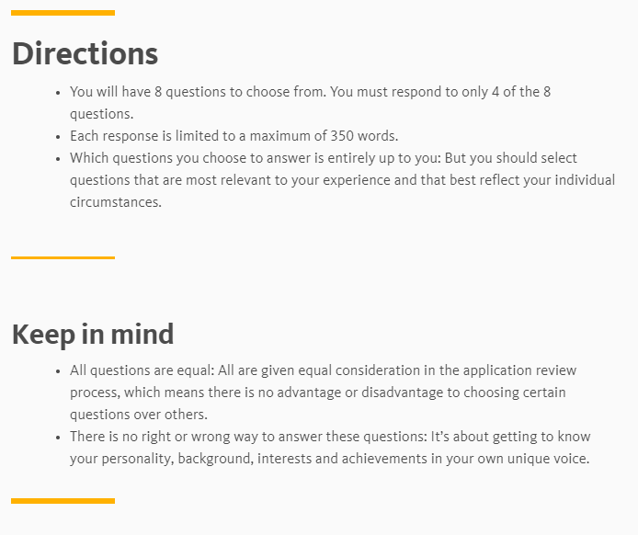

Slide 37
Essays – Personal Statement Words of Wisdom
“Consider your essay your interview on paper” – UC Berkeley
"Give careful thought to the questions asked, but don’t try to write the answers that you think we want to hear; give us the answers that tell us about you." - Cornell University
"You don’t need to have had extraordinary experiences to write an extraordinary essay. You don’t need to have done incomparable things to be interesting." - Wellesley College
“Edit. Then edit again. Then again. There is no excuse for errors anywhere on your application or essay. None whatsoever. It should be flawless, people. Take the time to edit and review and revise your full application multiple times." - Tulane University

Slide 38
Common Myths
Senior year grades don’t count
I must declare a major
I should know what I want to do for the rest of my life
“C” students don’t go to 4-year colleges
CSU’s are not good schools
Community Colleges are only for student who didn’t do well in high school.

Slide 39
Paying for college…
Prepare to apply for Financial Aid – The Free Application for Federal Student Aid (FAFSA) opens October 1. Same is true for the CSS Profile which is required by fewer schools. These forms should be completed sooner rather than later.
FAFSA: Oct 1st - March 2nd https://studentaid.gov/
Dream Act https://dream.csac.ca.gov/
CSS Financial Profile (some private schools)
On College Board website
Deadlines are usually prior to application due dates https://cssprofile.collegeboard.org/
Timeline and materials needed are on the new LJHS college website: https://www.ljhscollegeinfo.com/timeline-to-apply-for-financial-aid.
Scholarships – website links in Xello, Fastweb, etc.

Slide 40
Xello
Update your email immediately!
Do not use your stu.sandi.net
**Email address should match the one used on your college applications! (Use an appropriate email address!!! ☺ )
My Surveys -
Class of 2022 College Application Plans
Student/Parent Input Questions
Resume

Slide 41
Students: Make your counselor appointments, starting 9/20…
A - Fe Ms. Crowley:
Fi - L Mr. Drozda:
M - Sc Mrs. Soria:
Se - Z Mr. McVay:

Slide 42
Helpful Links on the following slides
Xello tutorial
Application help videos
UC/CSU virtual tours
CSU application tutorial-coming soon
Adding academic courses- Common App
A Quick Reference Sheet with all links will be shared soon!

Slide 43
College Application Help
Xello: Adding Colleges/Teacher Recs/Transcripts
Xello training
UC Application:
Steps 1-9 (Be sure to watch # 4 Academic; 6 Activities, 8 Short Answers)
https://www.youtube.com/watch?v=oVf9r72D_zw&list=PL-yx76EbPhMd8BkiLRvWl_xPUKOXbPfWM&index=1
Common Application:
FERPA- https://www.youtube.com/watch?v=MNcr0rkLi7Q
Adding Colleges- https://www.youtube.com/watch?v=7gbCc_Dxfi0
Listing your current classes: https://drive.google.com/file/d/10xDKL3uP6lHqBwNTF58ONQf8Sp3G3QSl/view?usp=sharing
CSU Application:
Will be shared when made available.

Slide 44
Campus Virtual Tours:https://www2.calstate.edu/apply/choosing-a-campus (This link is on the Cal State Apply main site under Explore Campuses)
CSU Week - October 5th through October 9th: Short live sessions that provide a campus overview, information about the admission process and a question and answer portion. Pre-registration is required: https://www2.calstate.edu/apply/csuweek/Pages/first-year-incoming-freshman.aspx.
UC for You- Get to know the nine undergraduate campuses and ask questions about admission, majors, pre-professional programs and more.
October 3, 10 a.m. - 1 p.m. - California first-year students:
https://ucforyou.universityofcalifornia.edu/?mc_cid=de3de0d40d&mc_eid=949048897e

Slide 45
Questions?
Thank you for attending!

